Slide 1

Teaching material for a course in Software Project Management & Software Engineering – Part I

Slide 2
Chapter 2
In this chapter, we will learn
How is a project initiated?
What is a project charter?
What is project scope?
What are project objectives?
What project activities are performed during project initiation?

Slide 3
Part 1: Project Management
Chapter 2 (Project Initiation)
Software projects are initiated in the same manner as any other type of projects.
Project charter is made by the top management of the organization for starting a software project. Project charter basically defines the purpose for starting the project.
A detailed project scope is developed to define boundaries of the project. The scope will include what functionalities are needed in the software product to be developed. It will also define level of quality needed in the software product.

Slide 4
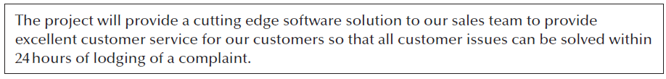
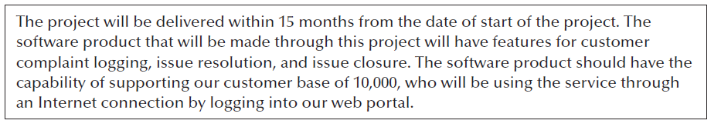
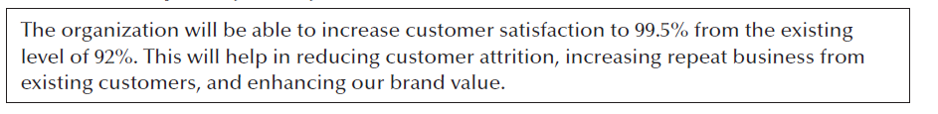
Part 1: Project Management Fundamentals
Chapter 2 (Project Initiation)
Sample project charter
Sample of project scope
Sample of project Objectives

Slide 5
Part 1: Project Management
Chapter 2 (Project Initiation)
An initial budget is estimated for the project. As per the estimate a budget is sanctioned for the project.
The budget includes costs to cover for salaries of people who will work on the software project, purchase of hardware, services, travel costs, management costs etc.

Slide 6
Part 1: Project Management
Chapter 2 (Project Initiation)
Project costs are directly related to size of the project. How much effort is needed to build the software product is the most crucial aspect for the project costs. The effort estimate will determine labor cost for the project.

Slide 7
Part 1: Project Management
Chapter 2 (Project Initiation)
An initial project schedule is prepared for the project. The entire project work is broken down into smaller tasks. Which tasks will start and end at what times determines the project schedule. Accurate estimation of duration of each task, dependencies of tasks on each other are the factors which help in making the project schedule accurately. After refinement, the initial project schedule later becomes the baseline schedule.
For better project effort & cost estimate, a technique known as project division can be used (popular in Australia & New Zealand). Here after preparing project charter and scope, an expert is hired who will make effort and cost estimate. Now bids are invited from software development companies for project planning & execution based on the effort & cost figured given by the expert.

Slide 8
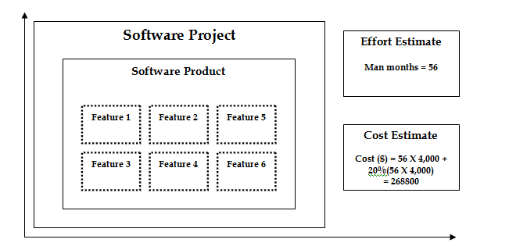
Part 1: Project Management Fundamentals
Chapter 2 (Project Initiation)
Initial project cost & effort estimate

Slide 9
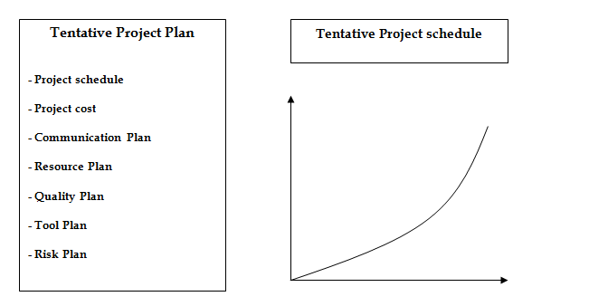
Part 1: Project Management Fundamentals
Chapter 2 (Project Initiation)
Tentative project plan and schedule

Slide 10
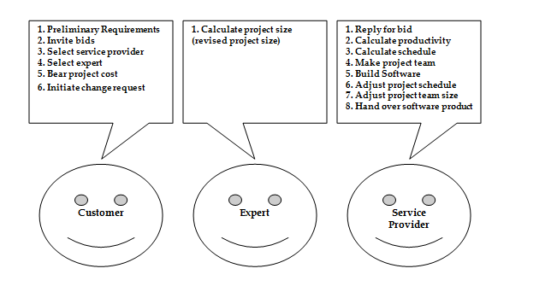
Part 1: Project Management Fundamentals
Chapter 2 (Project Initiation)
project division for better project size estimate

Slide 11
Objectives
Informally, the objective of a project can be defined by completing the statement:
The project will be regarded as a success if………………………………..
Rather like post-conditions for the project
Focus on what will be put in place, rather than how activities will be carried out
Notes:
The focus here needs to be on what the situation will be when the project is completed. In what ways will the world be different? The objectives should avoid describing activities:
e.g. ‘a new payroll application will be operational by 4th April’ not ‘design and code a new payroll application’

Slide 12
Objectives should be SMART
S – specific, that is, concrete and well-defined
M – measurable, that is, satisfaction of the objective can be objectively judged
A – achievable, that is, it is within the power of the individual or group concerned to meet the target
R – relevant, the objective must relevant to the true purpose of the project
T – time constrained: there is defined point in time by which the objective should be achieved
Notes:
I have seen some places where the R is said to stand for ‘resource-constrained’, that is that there is a target cost associated with the achievement of the objective.

Slide 13
Goals/sub-objectives
These are steps along the way to achieving the objective. Informally, these can be defined by completing the sentence…
Objective X will be achieved
IF the following goals are all achieved
A……………
B……………
C…………… etc
Notes:
Scoring a goal in football is a ‘goal’ or sub-objective on the way to achieving the overall objective of winning the match. Sub-objectives and objectives can be nested in a hierarchy, so that the objective of winning the match could itself be a goal or sub-objective on the way to winning the league etc.

Slide 14
Goals/sub-objectives continued
Often a goal can be allocated to an individual.
Individual may have the capability of achieving goal, but not the objective on their own e.g.
Objective – user satisfaction with software product
Analyst goal – accurate requirements
Developer goal – software that is reliable
Notes:
Goals can be formulated in such a way that they represent what an individual or group need to do to contribute to the success of the project’s objectives.
In the example above, the analyst or developer, by themselves, cannot guarantee user satisfaction. However, the analyst can contribute to the achievement of the objective by making sure the users’ requirements are accurately recorded and the developer by making sure that the software is reliable.
See Exercise 1.7 in the text.

